Slide 1
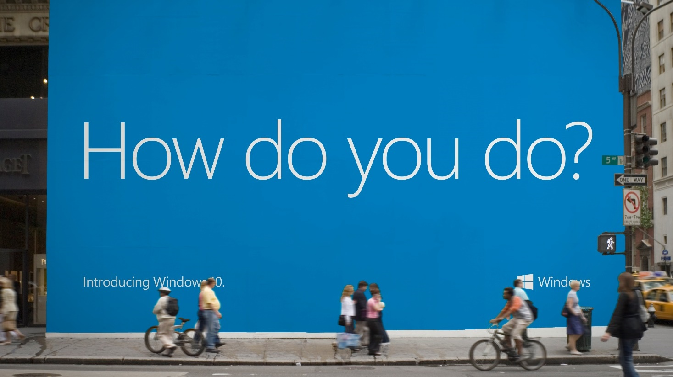

Slide 2

Universal Windows Platform Lessons Learned
João Almeida
DX – Developer Experience
joalmeid@microsoft.com
@jalmeida

Slide 3
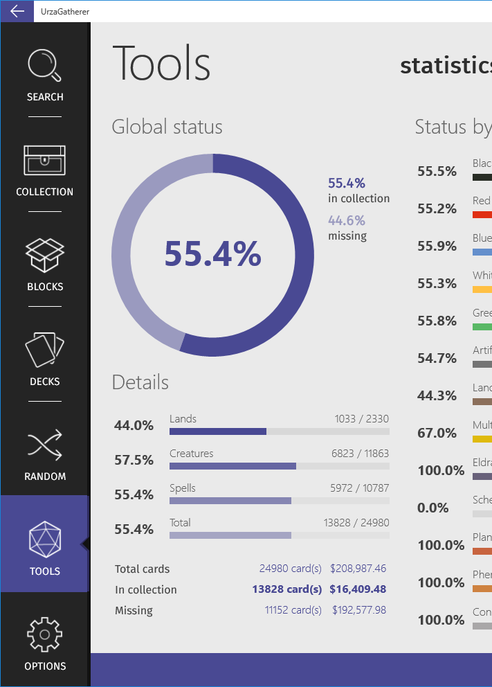
Goal
Lessons learned in a collection of
Feedbacks
Tricks
Thoughts
Learnings
…that we gathered during the development of an UWP app.

Slide 4
Design tricks for non-designers

Slide 5
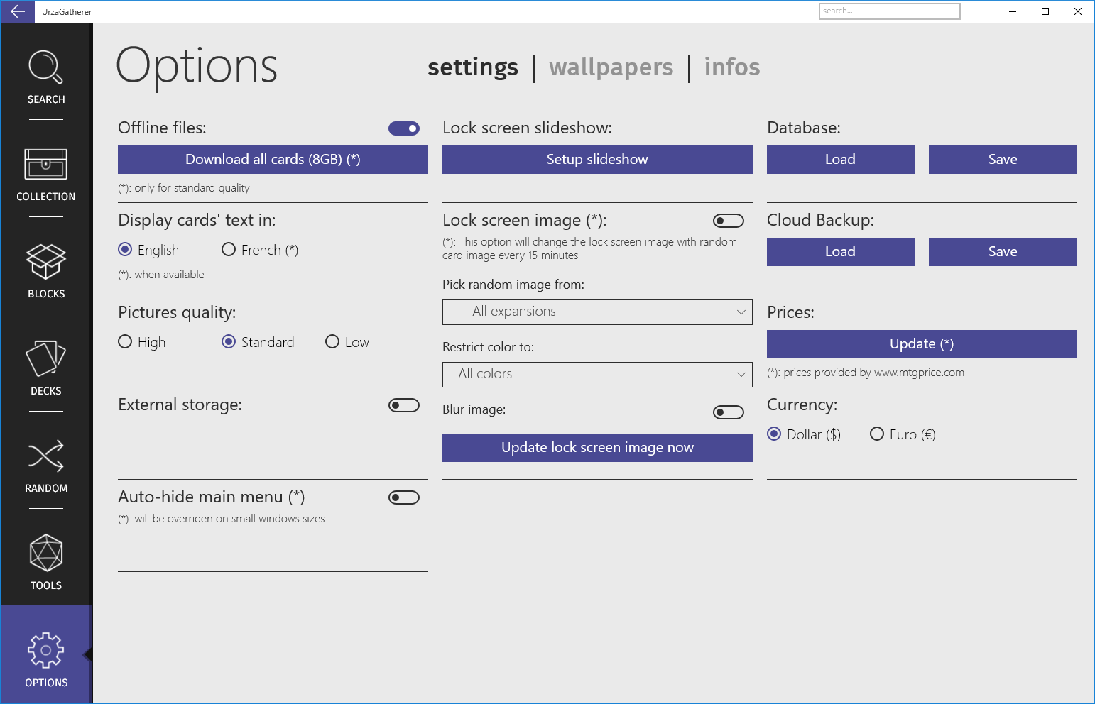
UI Techniques takeaways
It uses resolution independent Effective Pixels
Algorithm is based on a 4x4 grid
Ensure the guide points are divisible by 4
All values in XAML are now in Effective Pixels
Reposition, Reveal, Resize, Replace, Reflow, Re-architect
Use free color palettes
color.adobe.com
colorlovers.com
Think about design before you start coding

Slide 6
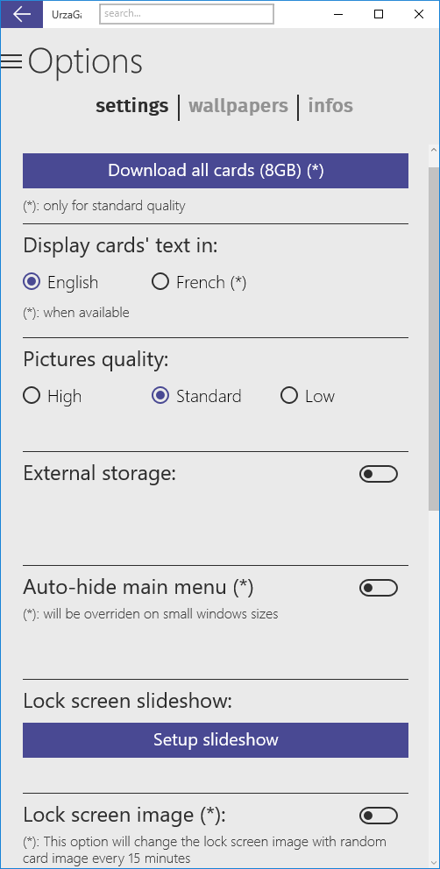
Our pick: Reflow
Work with Grid
Easy to implement
Move columns to lines when switching to mobile

Slide 7
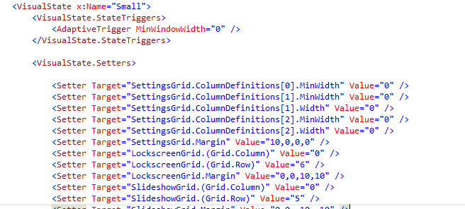
Reflow

Slide 8
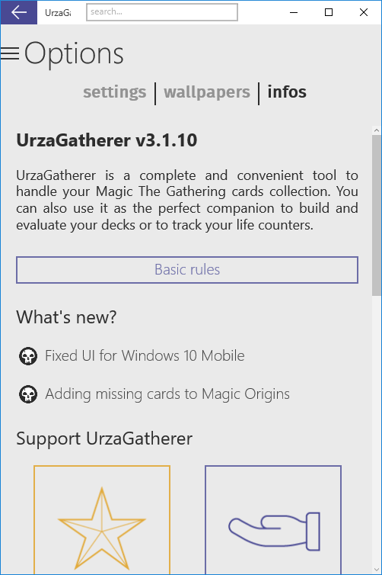
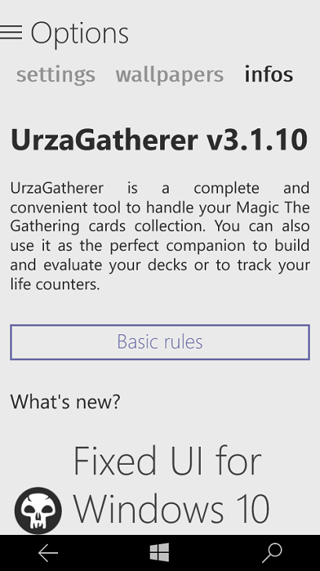
Font sizing
Effective pixel is great….
…but it does not work well all the times with font sizing
PC – ratio 100%
Mobile – ratio 200%

Slide 9
Font sizing
Use Adaptative trigger to compensate
Or use a FixedScaler (homemade):
<TextBlock local:FixedRescaler.FontSize="30"/>
Based on attached property
It computes current ratio:
var currentWidth = CoreWindow.GetForCurrentThread().Bounds.Width;
return currentWidth / 480.0;
And scales the font size accordingly

Slide 10
Performance tricks

Slide 11
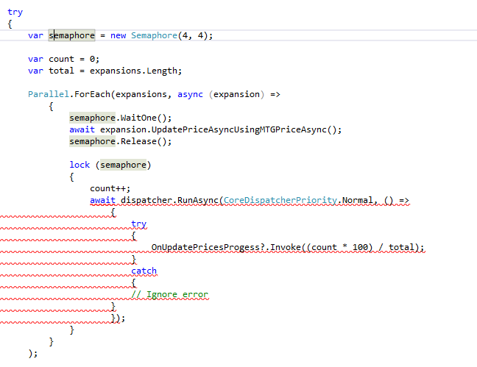

Abuse of Task and Parallel.Foreach
C# is incredibly powerful for parallelizing things
Do not forget to use SemaphoreSlim to protect your critical sections (lock does not work if you have an async code inside)

Slide 12
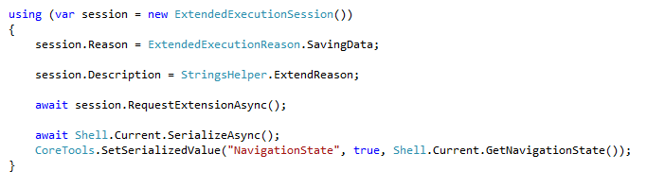
Json serialization could be slow
Mostly when suspending
But you can ask for more time:

Slide 13
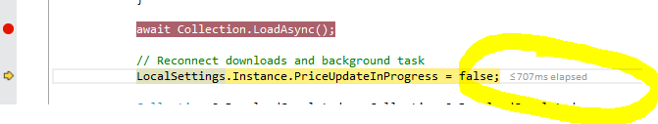
Using debug stopwatch
Really useful for debugging local performance issues (Start, suspend, etc..)

Slide 14
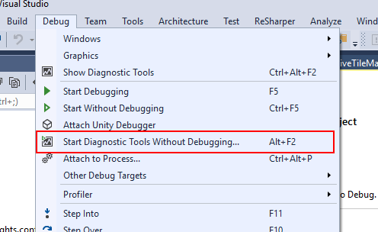
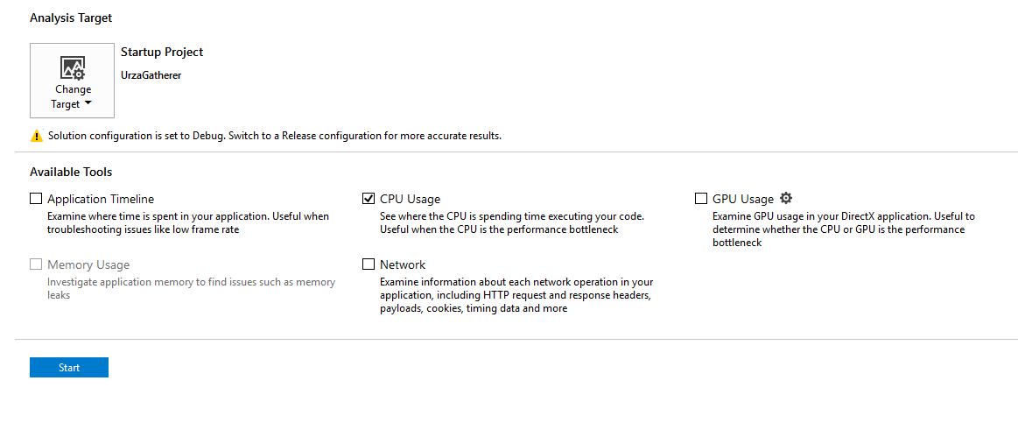
Using Visual Studio 2015 profiler

Slide 15
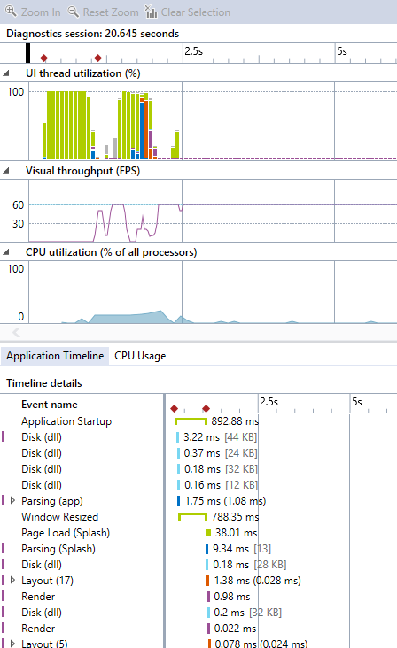
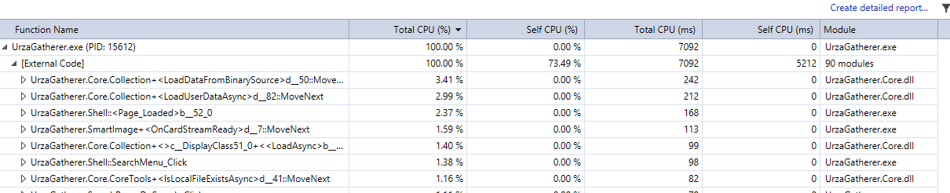
Using Visual Studio 2015 profiler

Slide 16
Fixing this **** uncatched exception
Or how to debug when everything works well on your computer

Slide 17
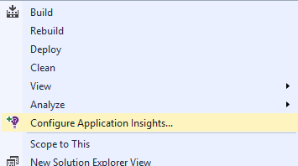
First of all, we need tools
Adding AppInsights to your app takes 5 minutes (really)

Slide 18
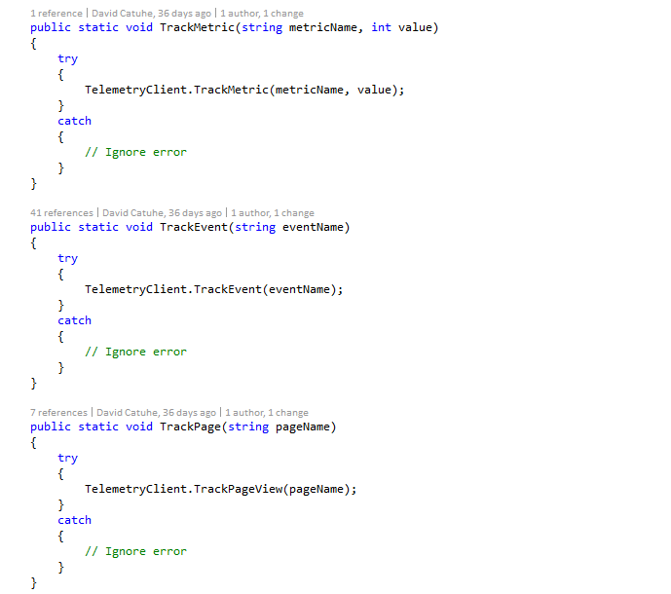
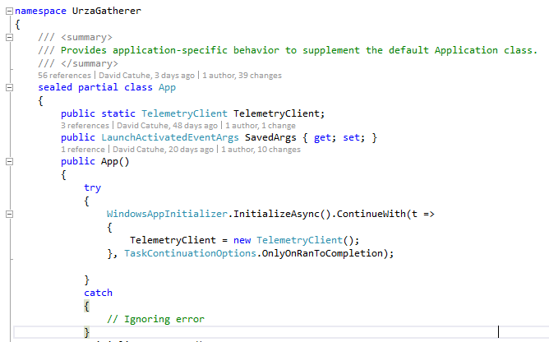
Enabling AppInsights

Slide 19
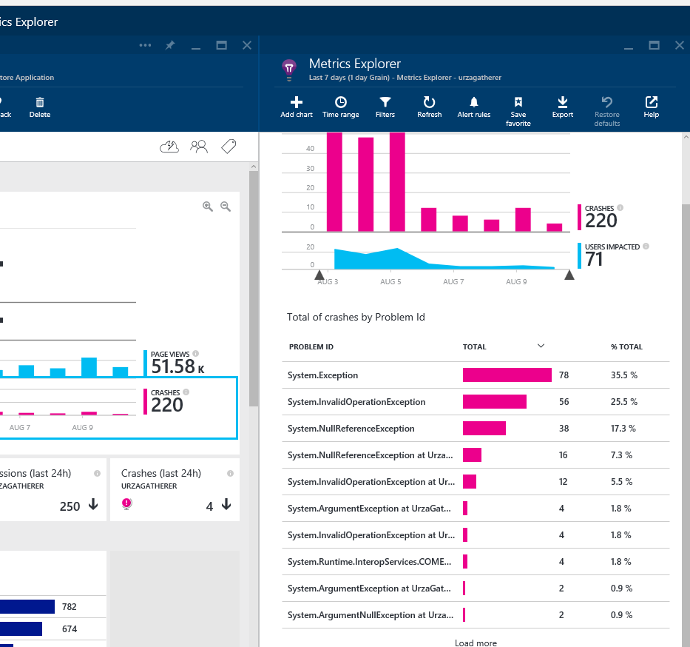
And then magic happens…
First report was…so sad ☺
220 crashes for 71 users…

Slide 20
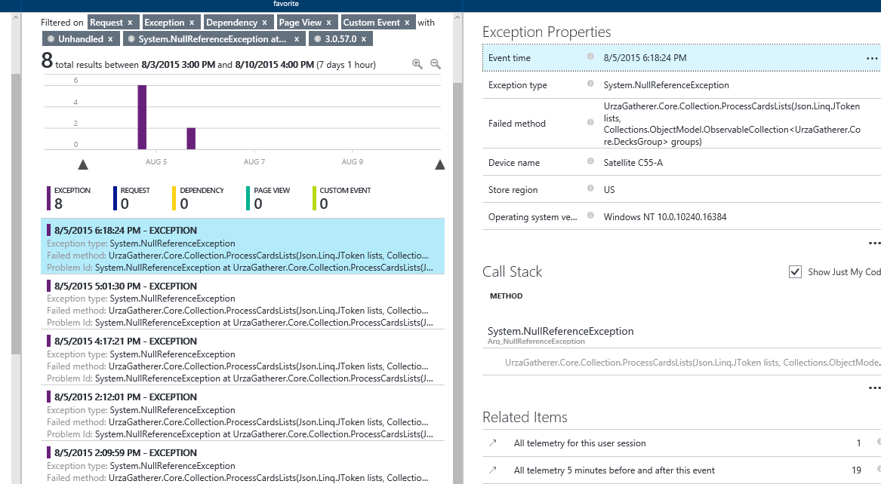
Hunting the beast down…

Slide 21
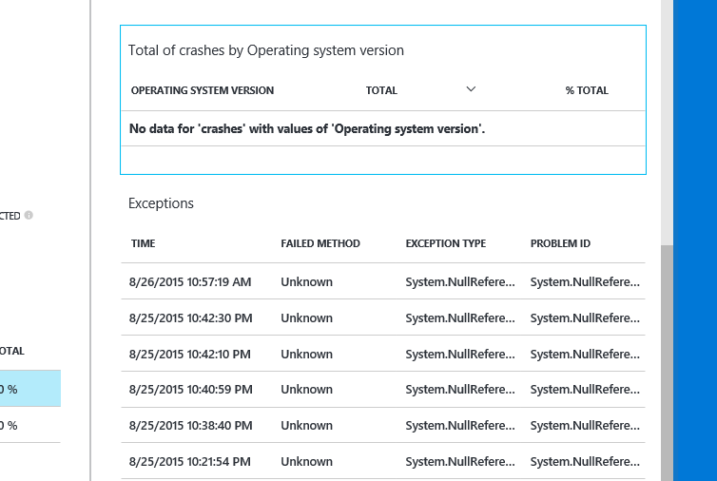
The mystery of “unknown method”

Slide 22
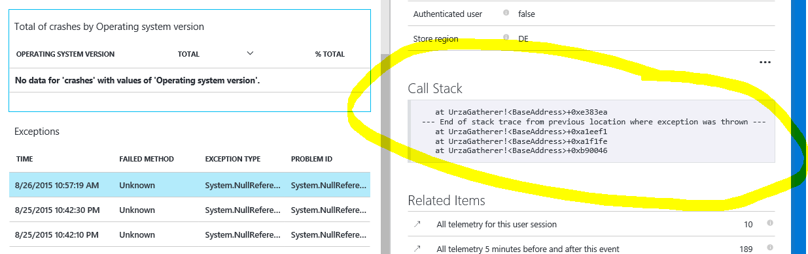
When there is no callstack…
Task.Run and Dispatcher.RunAsync has no callstack inside user code

Slide 23
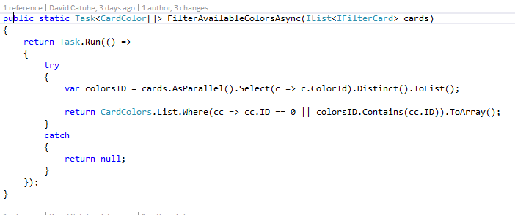
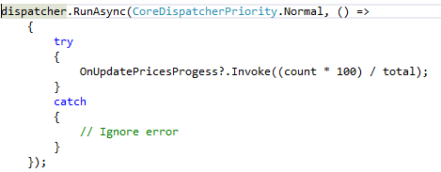
Never forget try/catch

Slide 24
Publishing to the store

Slide 25
C# want to be C++
Compiling in Release mode use .NetNative tools chain by default
So it is about generating native code..which is sloooooow…
…But faster at run time
.NetNative does not support all .Net features: (http://blogs.windows.com/buildingapps/2015/08/20/net-native-what-it-means-for-universal-windows-platform-uwp-developers)
Do not forget to test in release from time to time

Slide 26
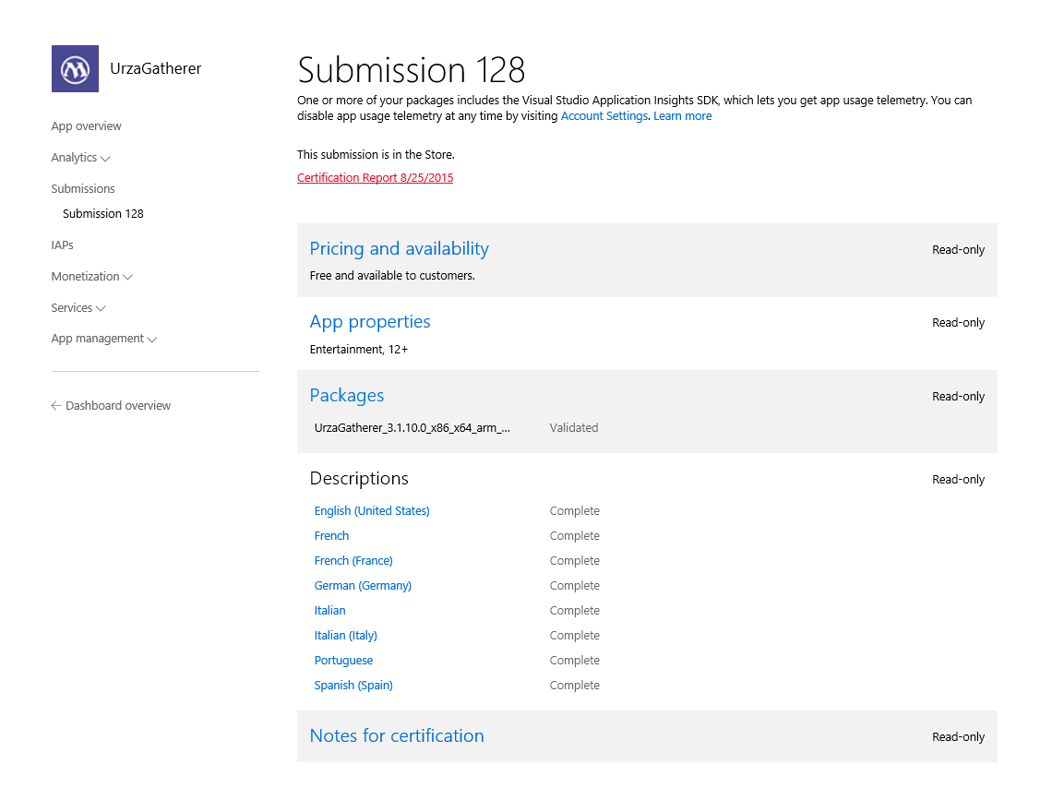
Publication

Slide 27
Staying connected with your users

Slide 28
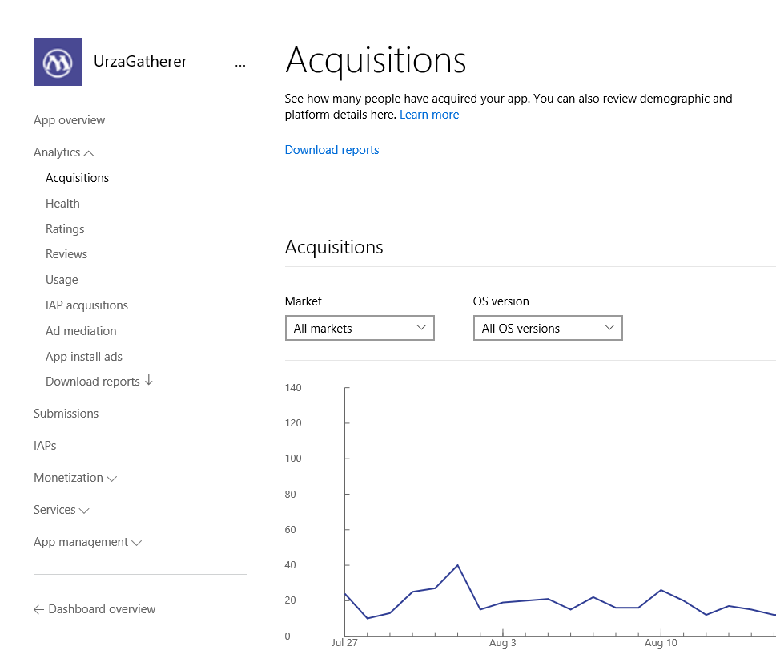
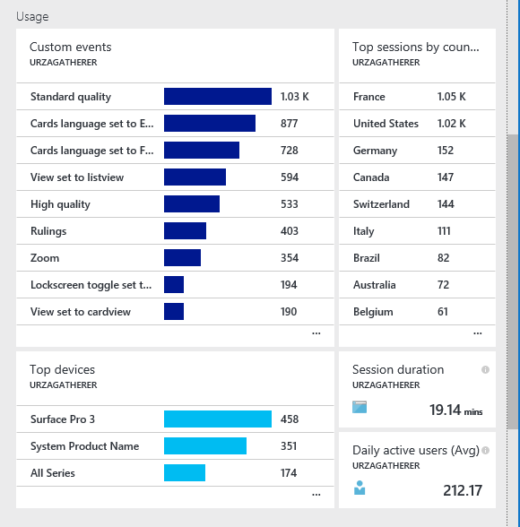
Analytics are the key
Store
AppInsights

Slide 29
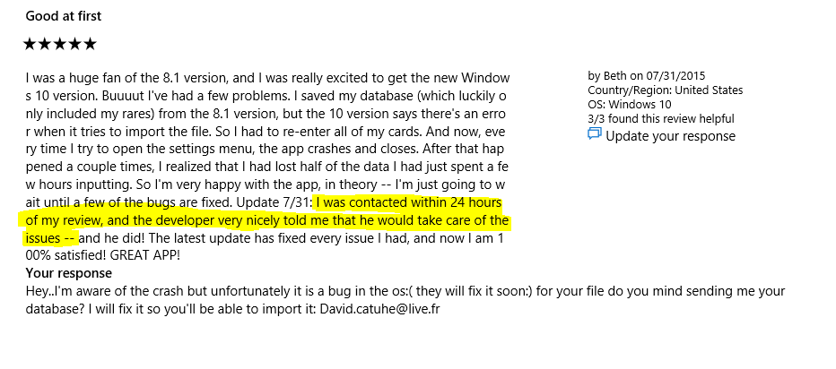
Respond to reviews

Slide 30
Convenient tools

Slide 31
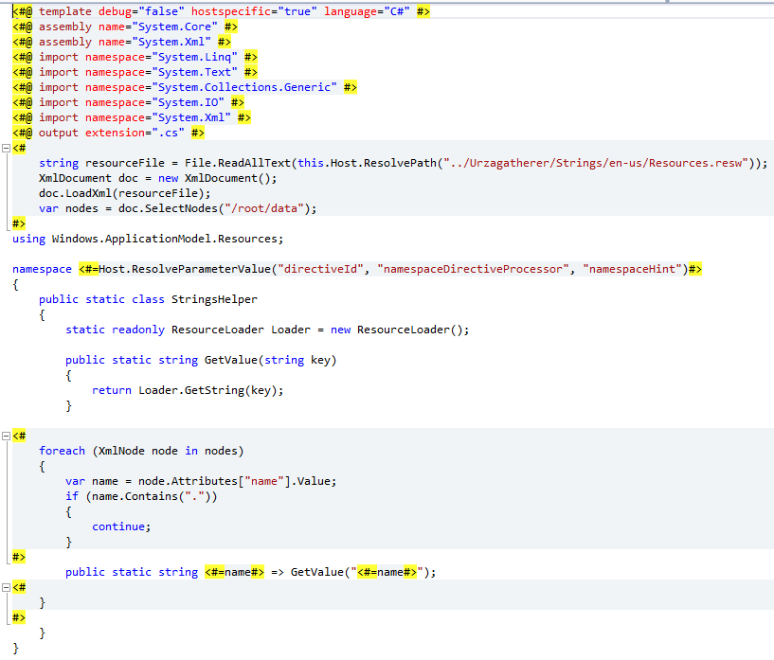
Using code template (.tt) to get typed resources

Slide 32
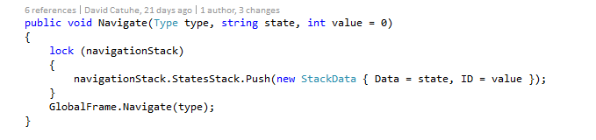
Use navigation stack to persist state
A great app has to be able to serialize navigation history
Using a stack of string is an easy way to keep track of your parameters
Stack can then be serialized using Json for instance

Slide 33
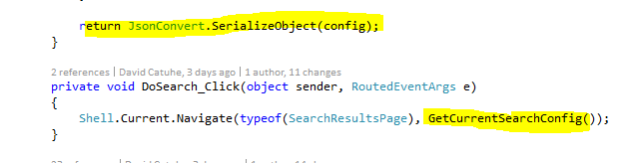
Do not rely on NavigationCache…
… if there are different ways to reach your page because there is only one state per page
Use a serializable state instead…

Slide 35
Adaptive design
Responsive design
Flexible layout responds to small changes
Many controls handle basic responsiveness
Adaptive design
Smart layout adjusts to large changes
Features like visual states aid in this design
Tailored design
A device-specific app can simplify design
Some devices have unique design languages

